Slide 1
CS3391 Object Oriented Programming
Dr.D.Sivaganesan, Professor,
PSGiTech / CSE

Slide 2
class Box { Multiple Objects
double width; double height; double depth;
}
class mulobjects
{ public static void main(String args[])
{ Box mybox1 = new Box();
Box mybox2= new Box();
double vol;
//assign values to mybox1's instance variables
mybox1.width=10;
mybox1.height=20;
mybox1.depth=5;
/* assign different values to mybox2's instance variables */
mybox2.width=3;
mybox2.height=6;
mybox2.depth=9;
// compute volume of first box
vol = mybox1.width * mybox1.height * mybox1.depth; System.out.println(" mybox1 Volume is " + vol);
// compute volume of second box
vol = mybox2.width * mybox2.height * mybox2.depth; System.out.println(" mybox2 Volume is " + vol);
} }

Slide 3
Assigning Object Reference Variables
Example :
Box b1 = new Box();
Box b2 = b1;
b2 is being assigned a reference to a copy of the object referred to by b1. b1 and b2 will both refer to the same object. The assignment of b1 to b2 did not allocate any memory or copy any part of the original object.
It simply makes b2 refer to the same object as does b1. Thus, any changes made to the object through b2 will affect the object to which b1 is referring, since they are the same object.

Slide 4
class Box {
double width; double height; double depth;
}
class mulobjects
{ public static void main(String args[])
{ Box mybox1 = new Box();
Box mybox2= mybox1; // Assigning Object Reference Variables
double vol;
//assign values to mybox1's instance variables
mybox1.width=10;
mybox1.height=20;
mybox1.depth=5;
/* assign different values to mybox2's instance variables */
mybox2.width=3;
mybox2.height=6;
mybox2.depth=9;
// compute volume of first box
vol = mybox1.width * mybox1.height * mybox1.depth;
System.out.println(" mybox1 Volume is " + vol);
// compute volume of second box
vol = mybox2.width * mybox2.height * mybox2.depth;
System.out.println(" mybox2 Volume is " + vol);
} }

Slide 5
Operators in Java
Operator is a symbol , used to perform specified operation.
Java provides a rich set of operators to manipulate variables.
Java operators into the following groups
Arithmetic Operators
Increment and Decrement
Bitwise Operators
Relational Operators
Boolean Operators
Assignment Operator
Ternary Operator

Slide 6
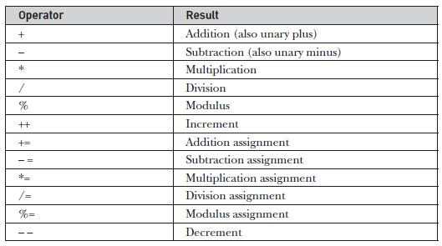
Arithmetic Operators
Arithmetic operators are used to manipulate mathematical expressions.

Slide 7
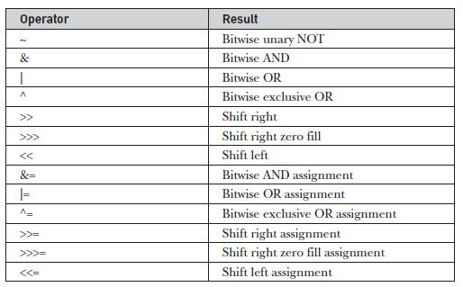
Bitwise Operators
Java defines several bitwise operators that can be applied to the integer types: long, int, short, char, and byte. These operators act upon the individual bits of their operands.

Slide 8
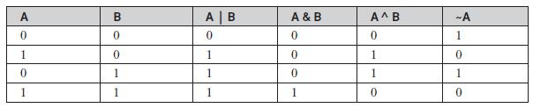
Bitwise Logical Operators The bitwise logical operators are &, |, ^, and ~. the bitwise operators are applied to each individual bit within each operand.

Slide 9
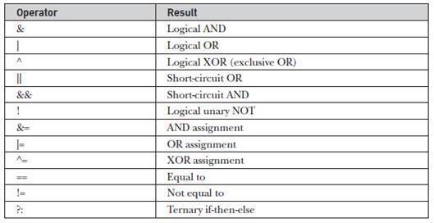
Relational Operators
The relational operators determine the relationship that one operand has to
the other.
Specifically, they determine equality and ordering.
The outcome of these operations is a boolean value.
Boolean Operators
The Boolean logical operators shown here operate only on boolean operands.
All of the binary logical operators combine two boolean values to form a
resultant boolean value.

Slide 10
Assignment Operator
The assignment operator is the single equal sign, =
Syntax:
var = expression;
Here, the type of var must be compatible with the type of expression.
Ex: int x, y, z;
x = y = z = 100; // set x, y, and z to 100
This fragment sets the variables x, y, and z to 100 using a single statement.
Ternary Operator
Ternary operator in java is used as one liner replacement for if-then-else statement and used a lot in java programming. it is the only conditional operator which takes three operands.
Syntax:
expression1 ? expression2 : expression3
Ex: int a=2;
int b=5;
int min=(a<b)?a:b;

Slide 11
CONTROL STATEMENTS
A programming language uses control statements to control the flow of execution of program based on certain conditions.
Selection statements
Iterative Statements
Selection Statements
if
if-else
nested-if
if-else-if
switch-case
jump – break, continue, return

Slide 12
ITERATIVE STATEMENTS
In programming languages, loops are used to execute a set of instructions/functions repeatedly when some conditions become true.
There are three types of loops in java.
while loop
do-while loop
for loop
for each

Slide 13
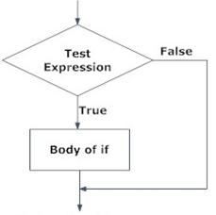
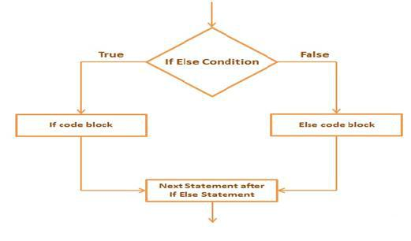
if Statement
if-else Statement

Slide 14
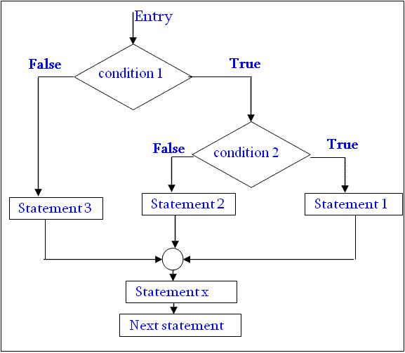
Nested if statement

Slide 15
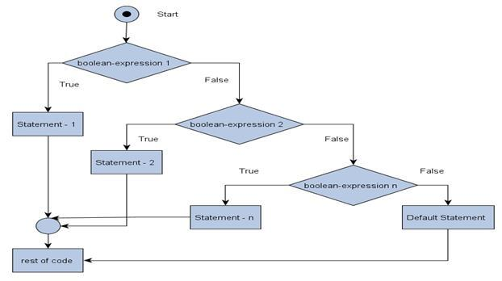
if else if ladder statement

Slide 16
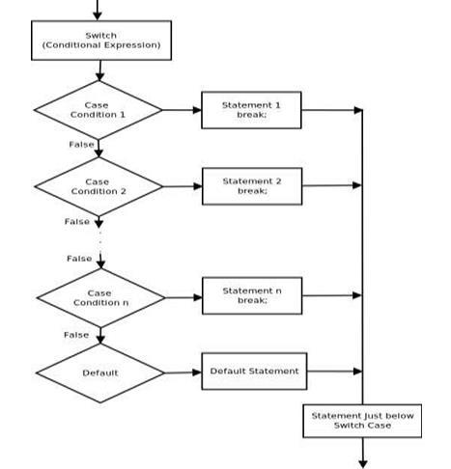
switch statement

Slide 17
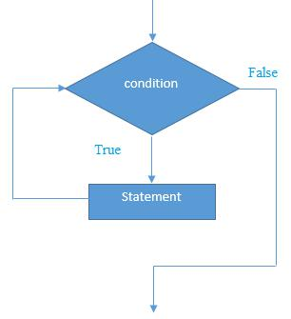
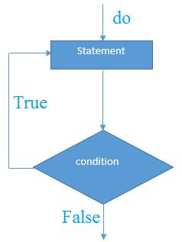
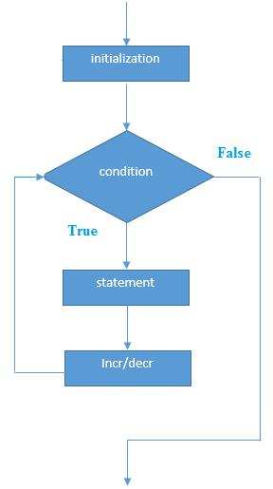
Looping /Iterative / Repetitive Statements
while loop do while loop for loop

Slide 18
Thank you

